Slide 1


Restaurant Management System
Imran Irshad
Abdul Rehman Abbasi

Slide 2

Introduction:
A restaurant management system is a digital solution designed to help restaurant owners and managers streamline their operations and improve their overall efficiency.
These systems typically include a range of features, such as order management, inventory tracking, User management (i.e., add, delete) and customer relationship management.
Overall, a well-designed restaurant management system can help restaurant owners and managers save time and money, while improving the overall customer experience and driving business success.

Slide 3
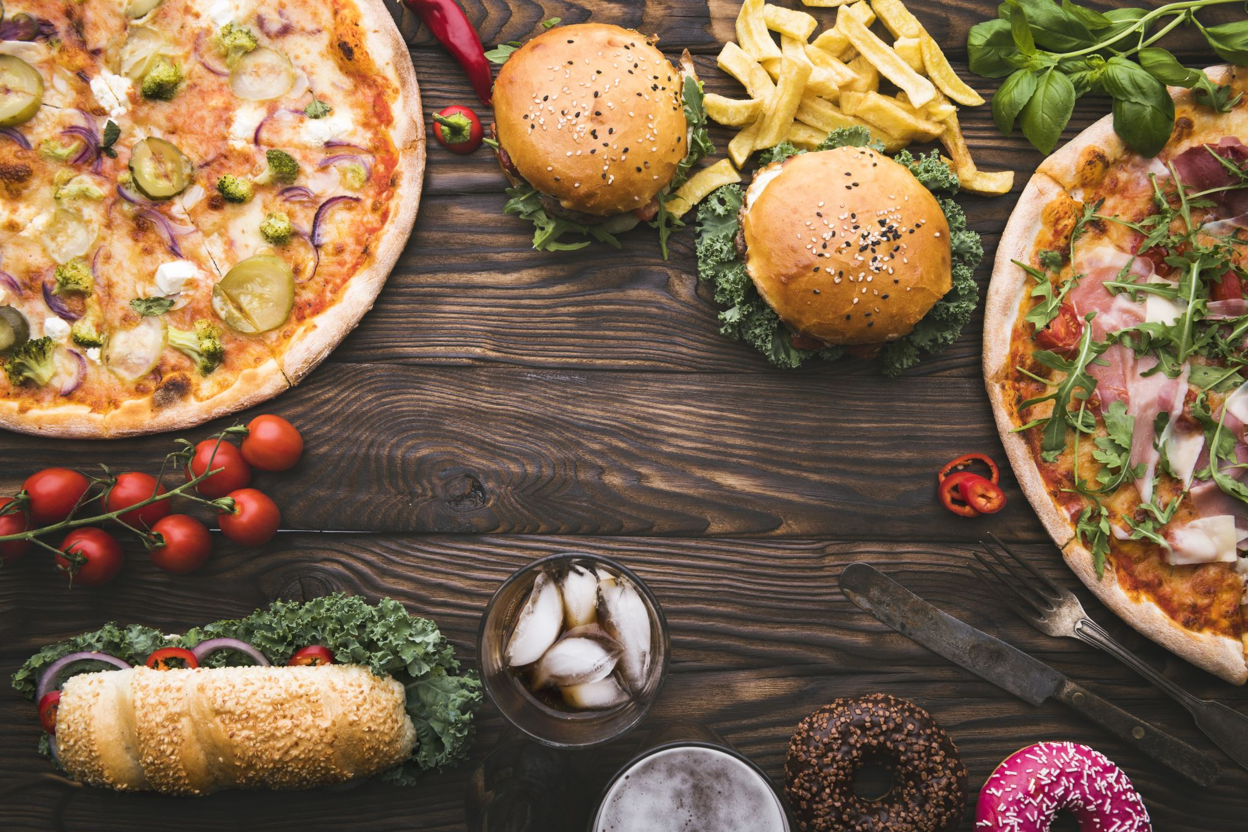
Project Client
The client for our project is "The Food Court," situated across from Pak Austria Fachhochschule; IAST in Mang, Haripur.
The establishment is a restaurant that specializes in fast food, cold drinks, and other similar offerings.
Its primary focus is on serving fast food, cold beverages, and other related items, making it a restaurant with a specific niche.

Slide 4
Functional Requirements
Functional requirements for a food management system includes:
Menu management
Order management
Table management
Inventory management

Slide 5

Non-Functional Requirements
Non-functional requirements for a food management system includes:
Performance
Security
User Friendly
Reliability
Availability

Slide 6

Technical Aspects
Language:
C#
DBMS:
MY SQL
Framework:
.NET

Slide 7

ER Diagram

Slide 8
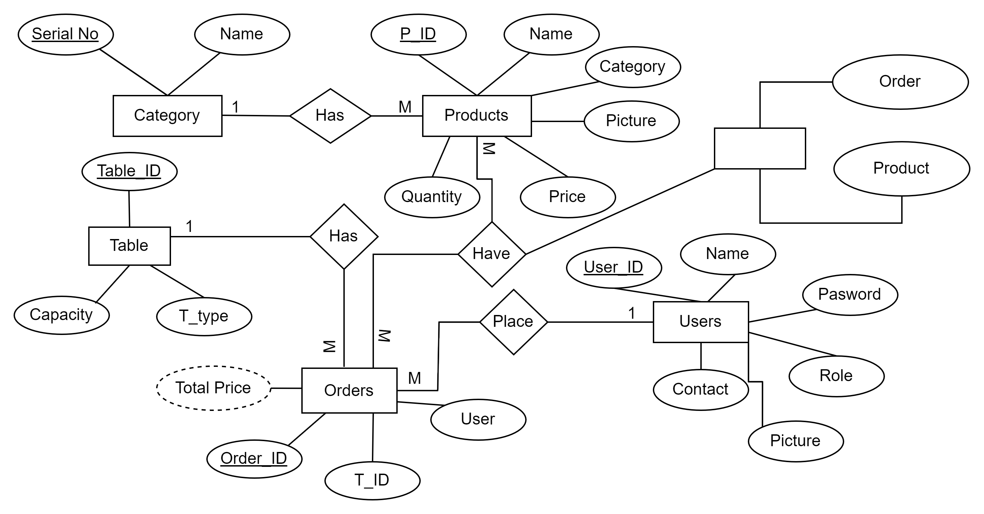

Slide 9


Thank You

